Slide 1
Presentation by Mitchell and Lesley CICC/ CPP representatives
and Robert From Investing in Children. CICC Update.
Funding from #Iwill has been secured to support older members of CICC/Care Leavers to lead on a Positive Relationship Project.
The purpose is to impact on domestic abuse and other forms of abuse, educating people at an early age through peer lead awareness workshop sessions in schools.
CICC members and the Virtual Heads Team.
Care experienced young people will be applying for funding to undertake educational activities via a CICC working group, who will oversee the project development. This is an exciting project as it increases the participation of young people to decide how the pupil premium is spent.
‘

Slide 2
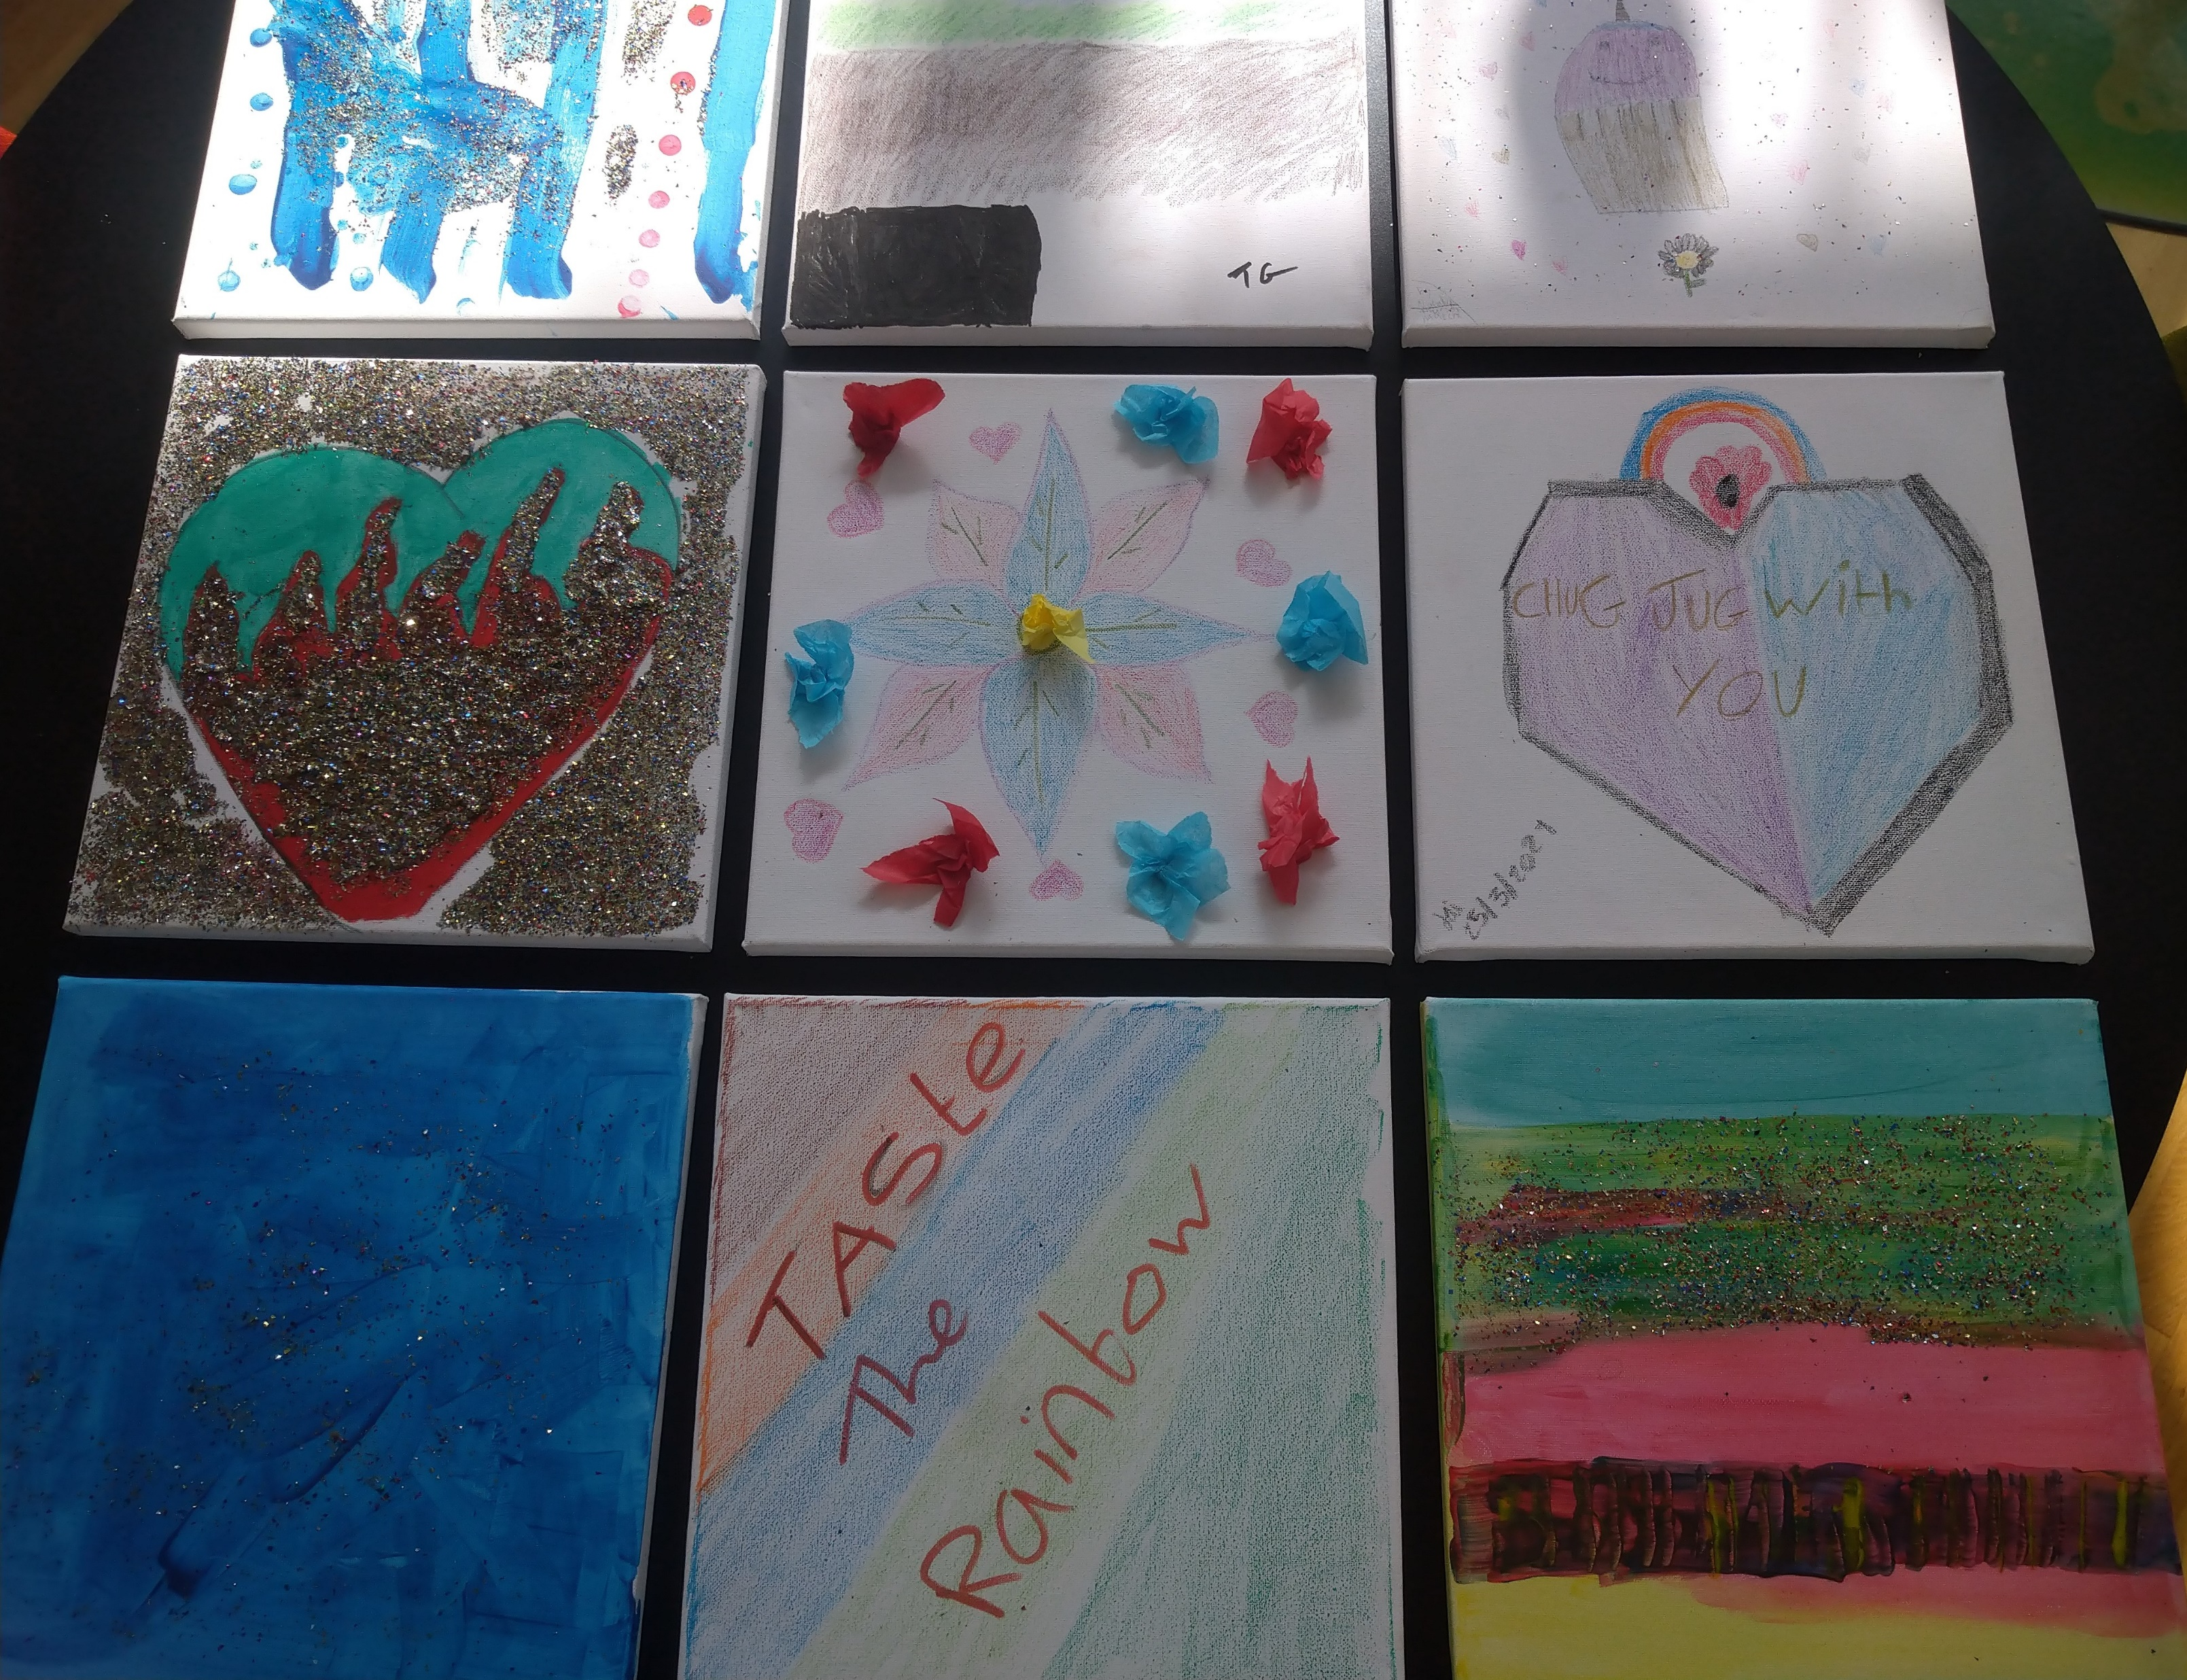
The first CICC face to face meeting since Covid-19 has taken place among the younger CICC group, developing art for the Full Circle service and planning additional meetings. 8 y/p attended and some of their work can be viewed below.
‘
CICC members have supported the launch of the Mind of Mine Own App.
CICC members have undertook interviews for new social workers.
The first in a series of podcasts has been launched called ‘ We are no different”, focusing on the experiences of the care system by two young people.

Slide 3
CICC members are developing the first ever Police Training session, which will be facilitated by young people and is being used as a pilot scheme to take place in May. Future training plans will be developed after the pilot session has been reviewed.
Peer mentoring training is be offered to some young people in children homes, along with continuous professional development training to staff via Investing in Children. A further 6 young people from CICC have also signed up to become peer mentors for the younger group.
Positive story-A young person has positively connected with the Children in Care Council, coming from Coxhoe children’s home, and has been developing information and undertaking the peer mentor program.
She has said “ Every child is a different kind of flower and together make the world a beautiful garden”.

Slide 4
